Slide 1
Microservice architecture
Microservices VS Monolith

Slide 2
What are microservices?
Microservices - also known as the microservice architecture - is an architectural style that structures an application as a collection of services that are;-
Highly maintainable and testable
Loosely coupled
Independently deployable
Organized around business capabilities
Owned by a small team
The microservice architecture enables the rapid, frequent and reliable delivery of large, complex applications.
It also enables an organization to evolve its technology stack.

Slide 3

Monolithic architecture
Monolith means composed all in one piece.
The Monolithic application describes a single-tiered software application in which different components combined into a single program from a single platform.
Consider an example of Ecommerce application, that authorizes customer, takes an order, check products inventory, authorize payment and ships ordered products.
This application consists of several components including e-Store User interface for customers (Store web view) along with some backend services to check products inventory, authorize and charge payments and shipping orders.

Slide 4
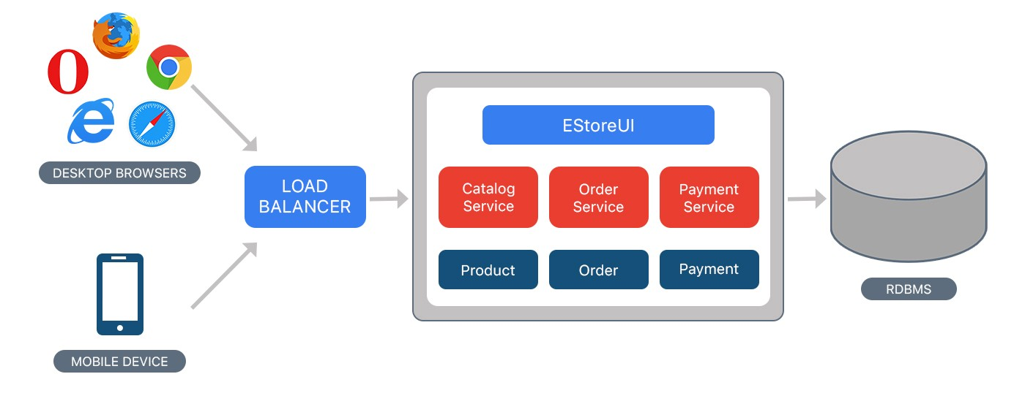
Monolithic architecture

Slide 5
Microservice Architecture - Context
You are developing a server-side enterprise application.
It must support a variety of different clients including desktop browsers, mobile browsers and native mobile applications.
The application might also expose an API for 3rd parties to consume.
It might also integrate with other applications via either web services or a message broker.
The application handles requests (HTTP requests and messages) by executing business logic; accessing a database; exchanging messages with other systems; and returning a HTML/JSON/XML response.
There are logical components corresponding to different functional areas of the application.

Slide 6
Microservice Architecture - Forces
There is a team of developers working on the application
New team members must quickly become productive
The application must be easy to understand and modify
You want to practice continuous deployment of the application
You must run multiple instances of the application on multiple machines in order to satisfy scalability and availability requirements
You want to take advantage of emerging technologies (frameworks, programming languages, etc…)

Slide 7
Problem
What’s the application’s deployment architecture?

Slide 8
Microservice Architecture - solution
Define an architecture that structures the application as a set of loosely coupled, collaborating services. Each service is:
Highly maintainable and testable - enables rapid and frequent development and deployment
Loosely coupled with other services - enables a team to work independently most of the time on their service(s) without being impacted by changes to other services and without affecting other services
Independently deployable - enables a team to deploy their service without having to coordinate with other teams
Capable of being developed by a small team - essential for high productivity by avoiding the high communication head of large teams

Slide 9
Example - Fictitious e-commerce application
Let’s imagine that you are building an e-commerce application that takes orders from customers, verifies inventory and available credit, and ships them.
The application consists of several components including the StoreFrontUI, which implements the user interface, along with some backend services for checking credit, maintaining inventory and shipping orders.
The application consists of a set of services

Slide 10
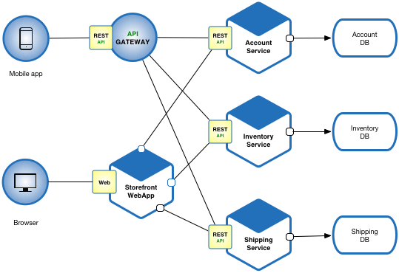
Example - Fictitious e-commerce application

Slide 11
Microservice Architecture - Benefits
1. Enables the continuous delivery and deployment of large, complex applications.
Improved maintainability - each service is relatively small and so is easier to understand and change
Better testability - services are smaller and faster to test
Better deployability - services can be deployed independently
It enables you to organize the development effort around multiple, autonomous teams. Each team owns and is responsible for one or more services. Each team can develop, test, deploy and scale their services independently of all of the other teams.

Slide 12
Microservice Architecture - Benefits
2. Each microservice is relatively small:
Easier for a developer to understand
The IDE is faster making developers more productive
The application starts faster, which makes developers more productive, and speeds up deployments
3. Improved fault isolation. For example, if there is a memory leak in one service then only that service will be affected. The other services will continue to handle requests. In comparison, one misbehaving component of a monolithic architecture can bring down the entire system.

Slide 13
Microservice Architecture - Benefits
4. Eliminates any long-term commitment to a technology stack. When developing a new service you can pick a new technology stack. Similarly, when making major changes to an existing service you can rewrite it using a new technology stack

Slide 14
Microservice Architecture – drawbacks
Developers must deal with the additional complexity of creating a distributed system:
Developers must implement the inter-service communication mechanism and deal with partial failure
Implementing requests that span multiple services is more difficult
Testing the interactions between services is more difficult
Implementing requests that span multiple services requires careful coordination between the teams
Developer tools/IDEs are oriented on building monolithic applications and don’t provide explicit support for developing distributed applications.

Slide 15
Microservice Architecture – drawbacks
2. Deployment complexity. In production, there is also the operational complexity of deploying and managing a system comprised of many different services.

Slide 16
Issues - When to use the microservice architecture?
One challenge with using this approach is deciding when it makes sense to use it.
When developing the first version of an application, you often do not have the problems that this approach solves.
Moreover, using an elaborate, distributed architecture will slow down development.
This can be a major problem for startups whose biggest challenge is often how to rapidly evolve the business model and accompanying application.
Later on, however, when the challenge is how to scale and you need to use functional decomposition, the tangled dependencies might make it difficult to decompose your monolithic application into a set of services.

Slide 17
Issues - How to decompose the application into services?
Another challenge is deciding how to partition the system into microservices. This is very much an art, but there are a number of strategies that can help:
Decompose by business capability and define services corresponding to business capabilities e.g. Inventory management, Order management etc..
Decompose by domain-driven design subdomain.
Decompose by verb or use case and define services that are responsible for particular actions. e.g. a Shipping Service that’s responsible for shipping complete orders. Decompose by by nouns or resources by defining a service that is responsible for all operations on entities/resources of a given type. e.g. an Account Service that is responsible for managing user accounts.
Ideally, each service should have only a small set of responsibilities

Slide 18
Issues - How to maintain data consistency?
In order to ensure loose coupling, each service has its own database.
Maintaining data consistency between services is a challenge because 2 phase-commit/distributed transactions is not an option for many applications.
An application must instead use the Saga pattern. A service publishes an event when its data changes.
Other services consume that event and update their data

